Slide 1


Introduction to Data Management Planning
Joy Davidson
Digital Curation Centre

Slide 2

“Data sets are becoming the new instruments of science”
Dan Atkins, University of Michigan

Slide 3

Funders’ expectations of public access
“Publicly funded research data are a public good, produced in the public interest, which should be made openly available with as few restrictions as possible in a timely and responsible manner that does not harm intellectual property.”
RCUK Common Principles on Data Policy
http://www.rcuk.ac.uk/research/Pages/DataPolicy.aspx

Slide 4
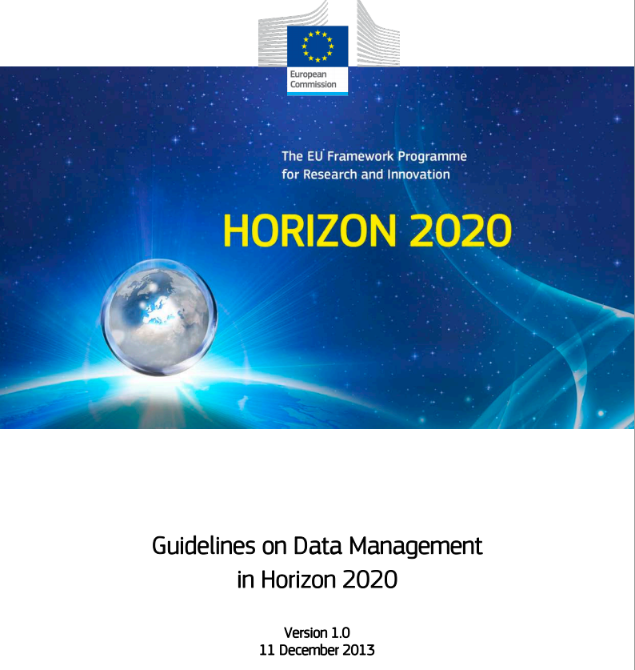
EU Policies
http://ec.europa.eu/research/participants/data/ref/h2020/grants_manual/hi/oa_pilot/h2020-hi-oa-data-mgt_en.pdf

Slide 5

Ultimately funders expect:
timely release of data
once patents are filed or on (acceptance for) publication
open data sharing
minimal or no restrictions if possible
preservation of data
typically 5-10+ years if of long-term value
See the RCUK Common Principles on Data Policy:
www.rcuk.ac.uk/research/Pages/DataPolicy.aspx

Slide 6
Data Management Planning
Data Sharing
Data Management Planning

Slide 7
What is data sharing?
“… the practice of making data used for scholarly
research available to others.” [Wikipedia]
Who’s involved?
the data sharer
the data repository
the secondary data user
support staff
research participants
commercial partners

Slide 8

Reasons to share data
BENEFITS
Avoid duplication
Scientific integrity
More collaboration
Better research
Increased citation
9-30% increase shown in
study
(Piwowar H. and Vision T.J 2013 , https://peerj.com/preprints/1.pdf)
DRIVERS
Public expectations
Government agenda
RCUK Data Policy
www.rcuk.ac.uk/research/Pages/DataPolicy.aspx
UKRIO Code of Practice for Research
www.ukrio.org/what-we-do/code-of-practice-for-research/

Slide 9
Managing restrictions on sharing
Ethics
Balance data protection with data sharing
Informed consent – cover current and future use
Confidentiality – is anonymisation appropriate?
Access control – who, what, when?
IPR
Clarify copyright before research starts
Consider licensing options e.g. Creative Commons

Slide 10
How to share research data
Use appropriate repositories and data catalogues
http://databib.org
http://www.re3data.org/
Jisc/DCC research data registry (coming soon!)
License the data so it is clear how it can be reused
www.dcc.ac.uk/resources/how-guides/license-research-data
Make sure it’s clear how to cite the data
http://www.dcc.ac.uk/resources/how-guides/cite-datasets
Consider publishing a data paper based on your DMP http://metajnl.com/

Slide 11
Data Management Planning
Planning to Share
Data Management Planning

Slide 12
What is a DMP?
A short plan that outlines
what data you will create and how
how you will manage it
(storage, back-up, access…)
plans for data sharing and preservation
DMPs are often submitted as part of grant applications, but are useful whenever you’re creating data.
Create
Document
Use
Share
Preserve
Store

Slide 13
Why develop a DMP?
to help you manage your data
to provide guidelines for everyone to work to
to anticipate and avoid problems e.g. data loss
to avoid duplication, data loss & security breaches
to comply with funders requirements...

Slide 14
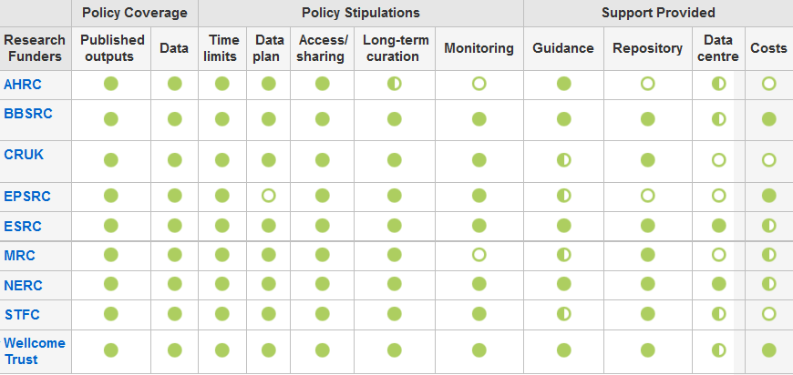
Research funders have DMP requirements
www.dcc.ac.uk/resources/policy-and-legal/overview-funders-data-policies

Slide 15
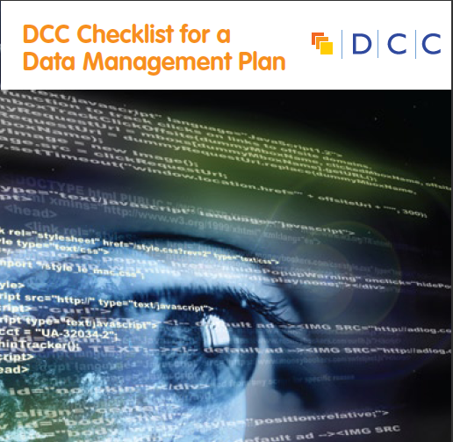
They typically want a short (c.1-2pp) statement covering:
What data will be created (format, types, volume...)
Standards and methodologies to be used (incl. metadata)
How ethics and Intellectual Property will be addressed
Plans for data sharing and access
Strategy for long-term preservation

Slide 16

http://credit.casrai.org/
Notes:
Led by Wellcome Trust and Digital Science Currently calling for comments on the proposed taxonomy which they are aiming to develop as an open standard.
A classification of the diverse roles played in the work leading to a research output. The classification includes, but is not limited to, traditional authorship roles. When there are multiple people serving in the same role a ‘degree of contribution’ should be further specified as either ‘lead’, ‘equal’, or ‘supporting’. Roles are intended to apply to all those who contribute to a project — and it is recommended that, if possible, all contributors be listed, whether or not they are formally listed as authors. It is also intended that multiple roles be assigned to a single person where appropriate.
14 terms proposed:
#1 conceptualization: Ideas; formulation or evolution of overarching research goals and aims.
#2 methodology: Development or design of methodology; creation of models.
#3 software: Programming, software development; designing computer programs; implementation of the computer code and supporting algorithms; testing of existing code components.
#4 validation: Verification, whether as a part of the activity or separate, of the overall replication/reproducibility of results/experiments and other research outputs.
#5 formal analysis: Application of statistical, mathematical, computational, or other formal techniques to analyse or synthesize study data.
#6 investigation: Conducting a research and investigation process, specifically performing the experiments, or data/evidence collection.
#7 resources: Provision of study materials, reagents, materials, patients, laboratory samples, animals, instrumentation, computing resources, or other analysis tools.
#8 data curation: Management activities to annotate (produce metadata), scrub data and maintain research data (including software code, where it is necessary for interpreting the data itself) for initial use and later re-use.
#9 writing – original draft: Preparation, creation and/or presentation of the published work, specifically writing the initial draft (including substantive translation).
#10 writing – review & editing: Preparation, creation and/or presentation of the published work by those from the original research group, specifically critical review, commentary or revision – including pre- or post-publication stages.
#11 visualization: Preparation, creation and/or presentation of the published work, specifically visualization/data presentation.
#12 supervision: Oversight and leadership responsibility for the research activity planning and execution, including mentorship external to the core team.
#13 project administration: Management and coordination responsibility for the research activity planning and execution.
#14 funding acquisition: Acquisition of the financial support for the project leading to this publication
16

Slide 17

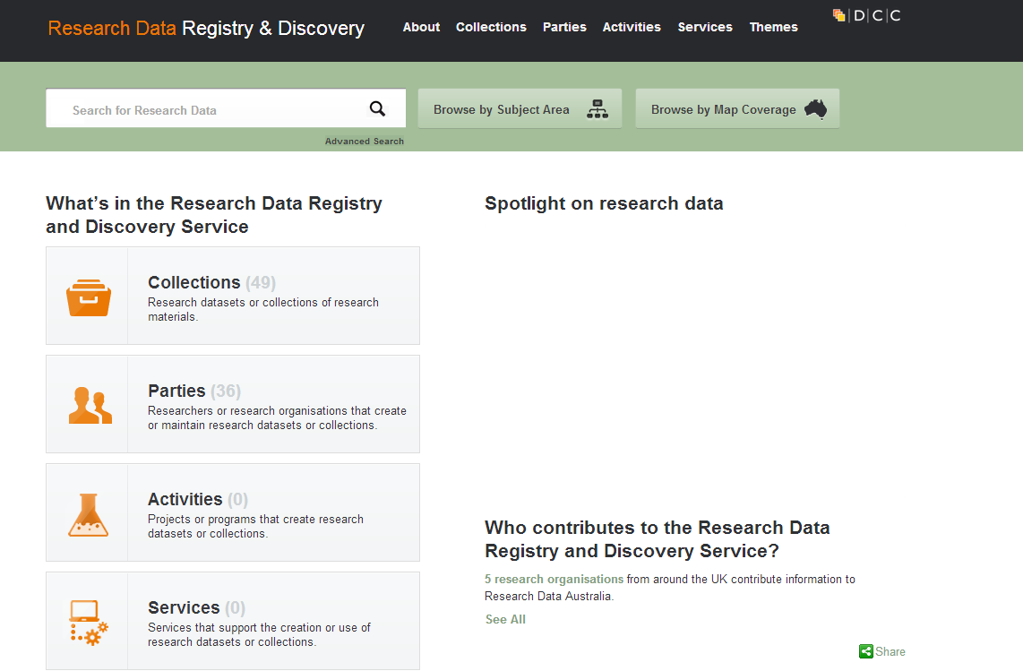

#1 conceptualization
Ideas; formulation or evolution of overarching research goals and aims.
Literature and data review, data management planning
https://dmponline.dcc.ac.uk/
http://www.re3data.org/
http://rdrds.cloudapp.net/registry/
Notes:
DMPonline; costing (4C roadmap)
17

Slide 18
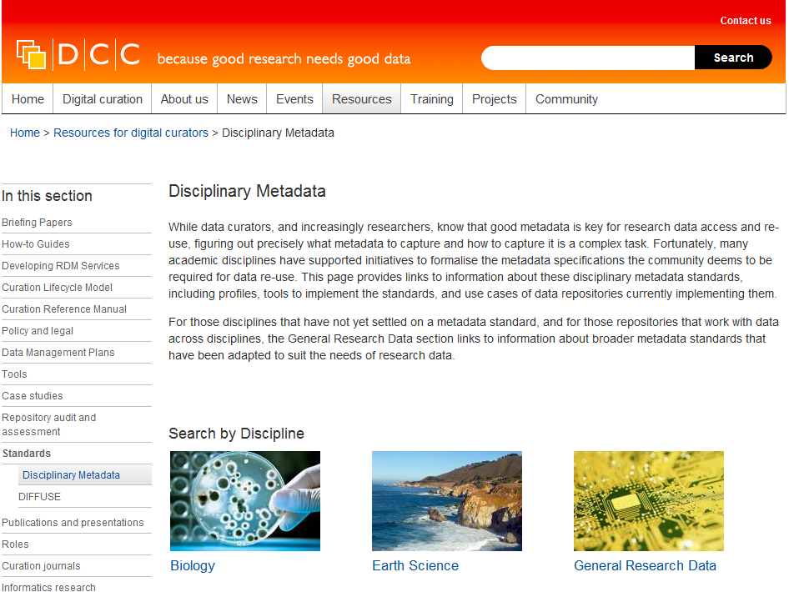
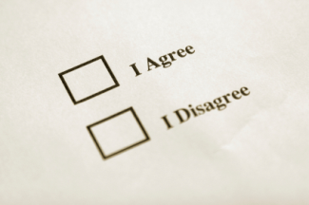
#2 methodology
Development or design of methodology; creation of models.
Standards, formats, consent
Informed consent
http://www.dcc.ac.uk/resources/metadata-standards
Notes:
Metadata; consent for sensitive data; data cleaning, anonymisation
18

Slide 19

#4 validation
Verification, whether as a part of the activity or separate, of the overall replication/reproducibility of results/experiments and other research outputs.
Selecting and appraising data to be retained
Image: http://www.verotechsolutions.net/Services4.html
Notes:
Validation? Longer-term value? Active selection (software, hardware); understanding workflows
19

Slide 20


#5 formal analysis
Application of statistical, mathematical, computational, or other formal techniques to analyse or synthesize study data.
Describing techniques in data catalogue records
http://www.software.ac.uk/
http://datacarpentry.org/
Notes:
Jisc national research data registry, ANDS Research Data Australia, data carpentry
Data Carpentry is a sister organization of Software Carpentry designed to teach basic concepts, skills and tools for working more effectively with data.
In many domains of research the rapid generation of large amounts of data is fundamentally changing how research is done. The deluge of data presents great opportunities, but also many challenges in managing, analyzing and sharing data. Data Carpentry teaches the skills that will enable researchers to be more effective and productive. Workshops are designed for learners with little to no prior knowledge of programming, shell scripting, or command line tools.
Learning objectives for the workshops: Researchers should be able to retrieve, view, manipulate, analyze and store their's and other's data in an open and reproducible way. Researchers learn best when material is taught in their domain, so workshops will be domain-specific.
We have already delivered several introductory workshops for biology that cover topics such as working more effectively with spreadsheets, using SQL for data management, and analyzing data with R and command-line tools.
20

Slide 21
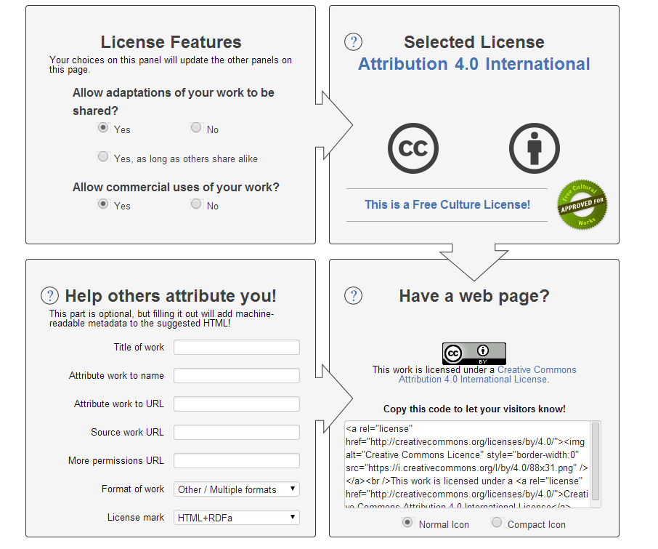
#6 investigation
Conducting a research and investigation process, specifically performing the experiments, or data/evidence collection.
Data collection; reuse of third party data; searching for existing datasets for reuse
http://creativecommons.org/choose/
Notes:
21

Slide 22
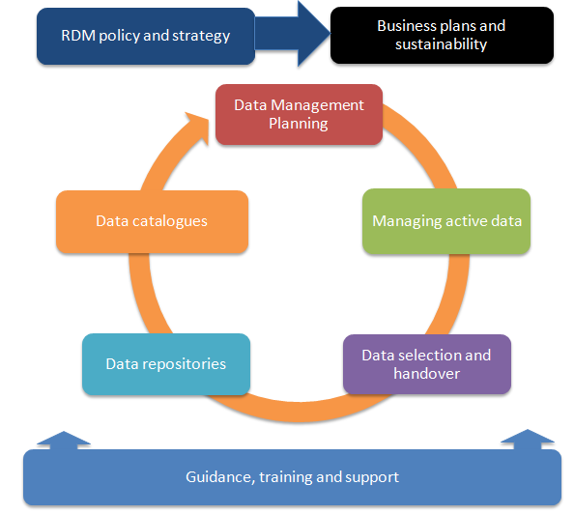
#8 data curation
Management activities to annotate (produce metadata), scrub data and maintain research data (including software code, where it is necessary for interpreting the data itself) for initial use and later re-use.
Determine curation requirements
http://www.dcc.ac.uk/resources/developing-rdm-services
Notes:
minimum vs gold-standard curation; Validation only? Other purposes (e.g., increased citation, inter-disciplinary use?); costing (CCEx, 4C Roadmap)
22

Slide 23
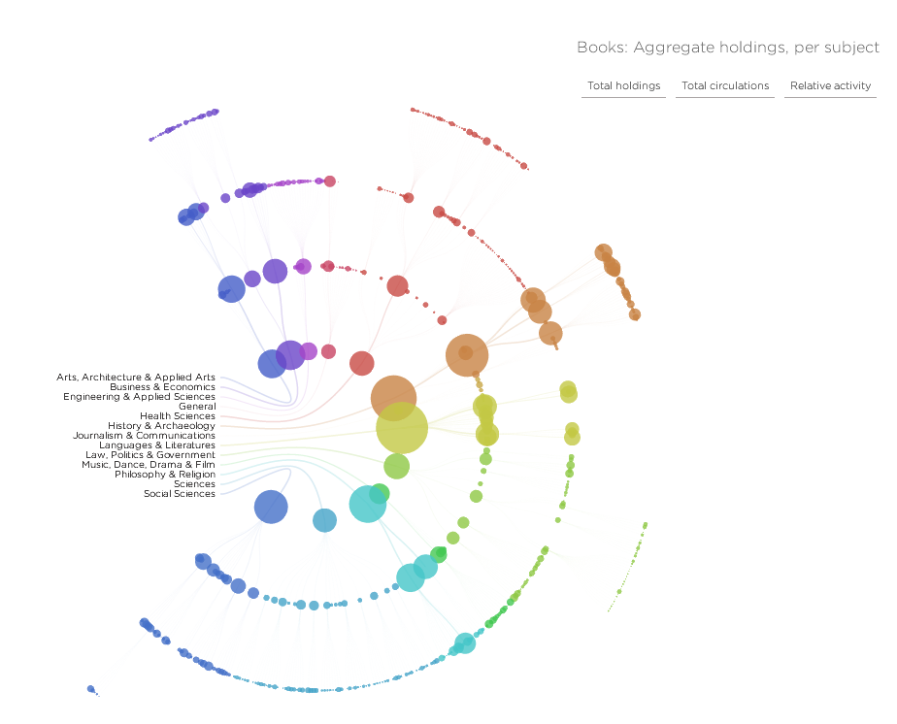
#11 visualization
Preparation, creation and/or presentation of the published work, specifically visualization/data presentation.
Data models and visualisations
http://spatialinformationdesignlab.org/project_sites/library/catalog.html
Notes:
advice on naming and storing data models and visualisations; e.g., is it the model or the algorithm that needs to be retained?, do we need to retain the data or point to it somewhere else?, are there any software licensing issues associated with rendering the visualisation that need to be addressed?
23

Slide 24


#12 supervision
Oversight and leadership responsibility for the research activity planning and execution, including mentorship external to the core team.
Training, supervising and advising other researchers
https://www.fosteropenscience.eu/
http://www.researchinfonet.org/infolit/ridls/
Notes:
InformAll’s aim is to provide a collaborative, multi-agency focus for promoting the relevance, importance and benefits of IL in the lives of individuals as they progress through education and beyond.
Informall brings together partners from different constituencies and professional groups which offer distinctive perspectives on the advancement of IL. It adopts a collective approach, by joint working which capitalises on these different outlooks to provide a widely-representative view on challenges to be addressed. It constitutes a pool of experts, for the benefit of different communities who wish to develop their interest, policies or activities in information-related knowledge, understanding, skills and confidence. The aims and objectives of the initiative can be found below.
24

Slide 25
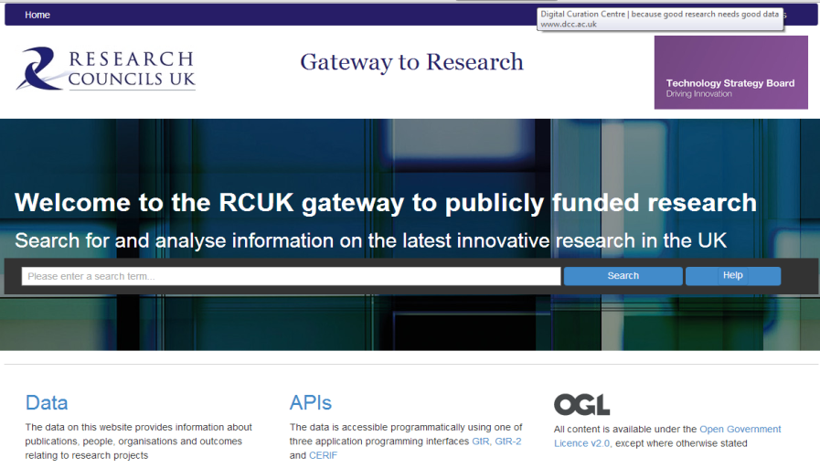
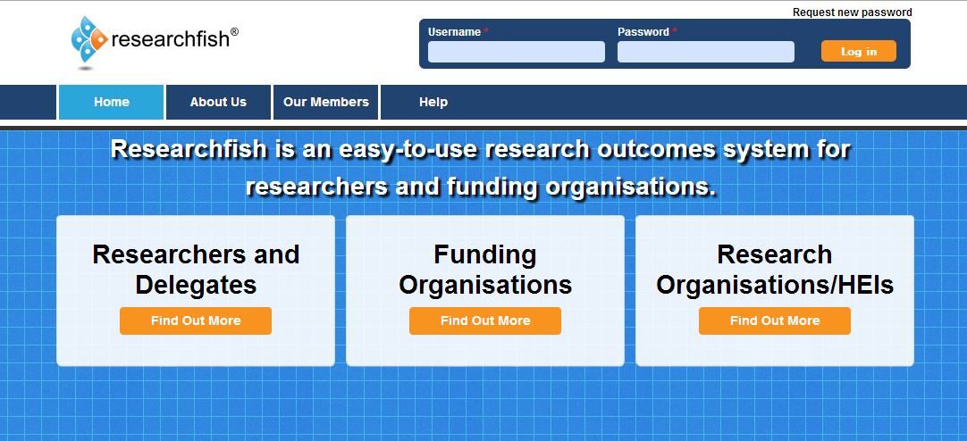
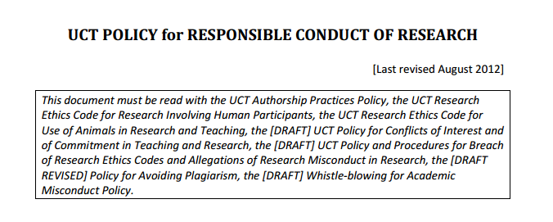
#13 project administration
Management and coordination responsibility for the research activity planning and execution.
Understanding institutional and funding body requirements
http://gtr.rcuk.ac.uk/
https://www.researchfish.com/
https://www.uct.ac.za/downloads/uct.ac.za/about/policies/UCTresearchconductpolicy.pdf
Notes:
ensuring that research outputs are ingested as planned, e.g., dmps to be stored in IR?, publish DMPs and assign DOI?, monitoring reuse and reporting on metrics
25

Slide 26
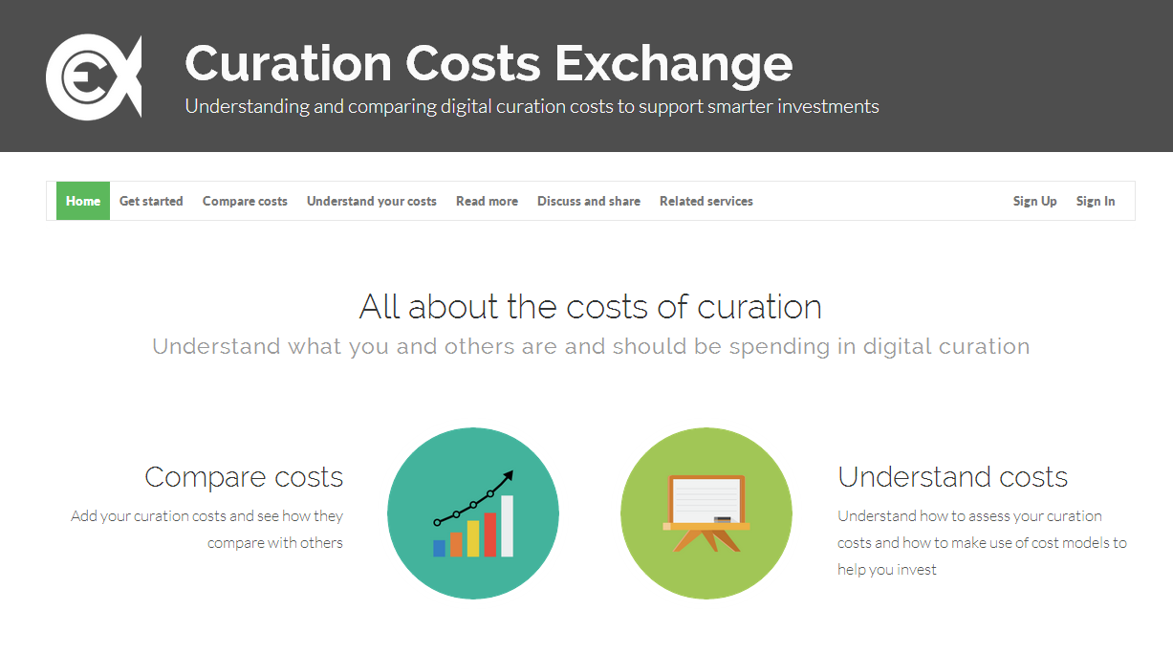
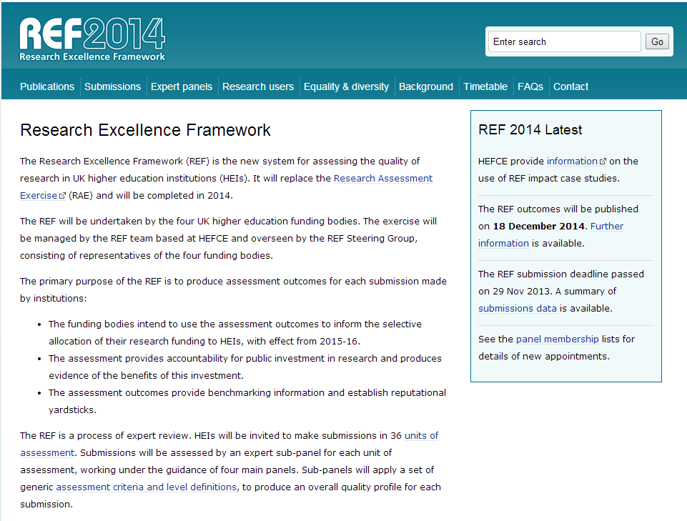
#14 funding acquisition
Acquisition of the financial support for the project leading to this publication.
Aware of funding body mandates relating to RDM and data sharing and related costs
http://www.curationexchange.org/
http://www.ref.ac.uk/
Notes:
Costs
26

Slide 27
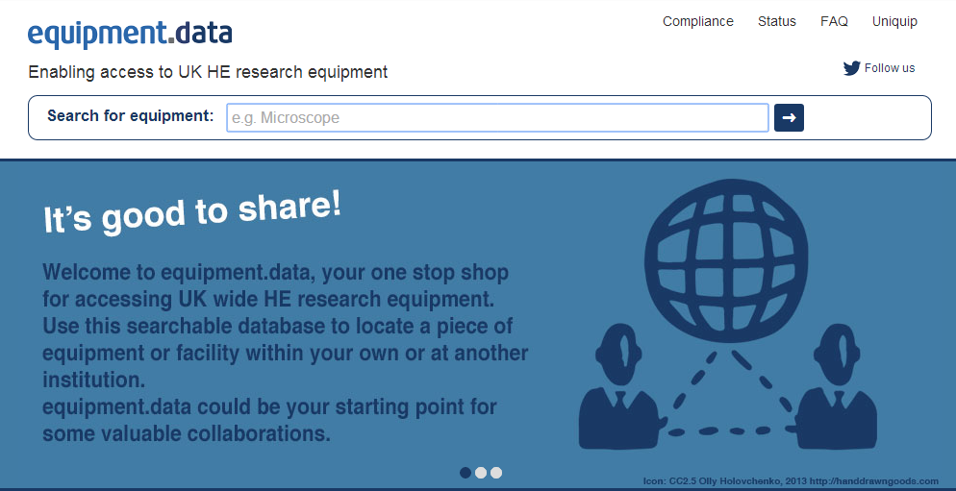
#7 resources
Provision of study materials, reagents, materials, patients, laboratory samples, animals, instrumentation, computing resources, or other analysis tools.
Documenting research methods and processes
http://equipment.data.ac.uk/
Notes:
References to non digital materials, advice on documenting tools, equipment and instruments (calibration, etc).
27

Slide 28
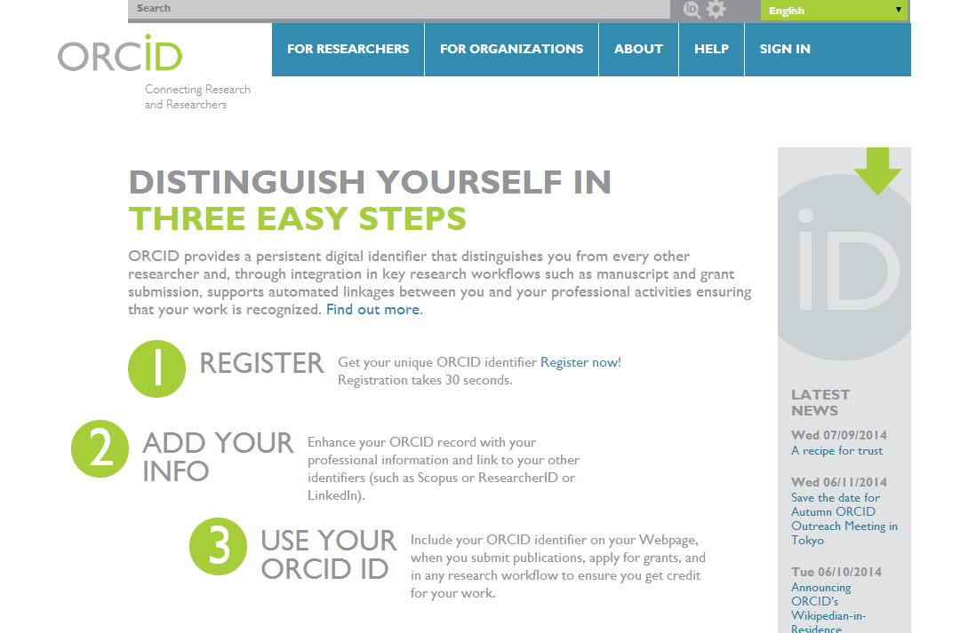

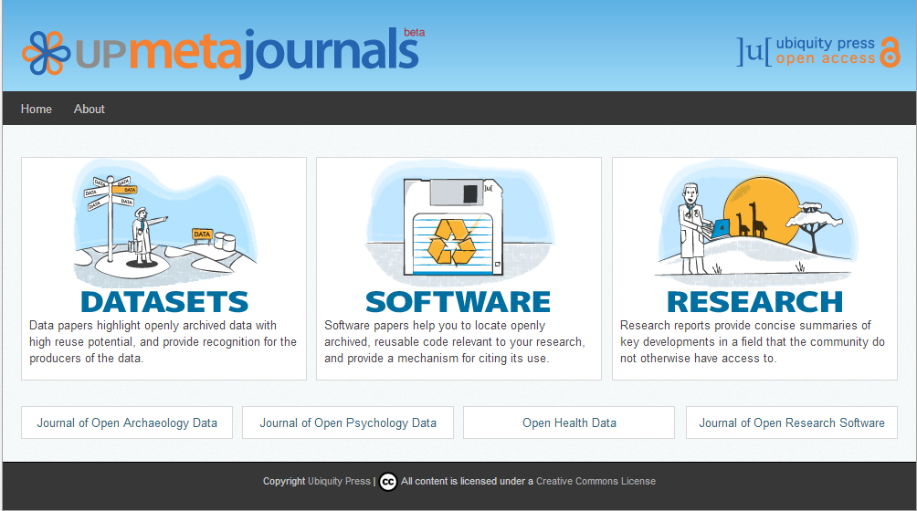

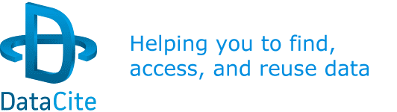
#9-10 writing – original draft; review and editing,
Preparation, creation and/or presentation of the published work, specifically writing the initial draft (including substantive translation).
Preparation, creation and/or presentation of the published work by those from the original research group, specifically critical review, commentary or revision – including pre- or post-publication stages.
Publishing
http://orcid.org/
https://www.force11.org/datacitation
http://www.metajnl.com/
https://www.datacite.org/
Notes:
on Open Access and identifiers, dealing with APCs, advising on publishers requirements, assigning DOIs, institutional repository, link between data set and published paper; DOIs
Promoting, monitoring usage and getting credit!
28

Slide 29
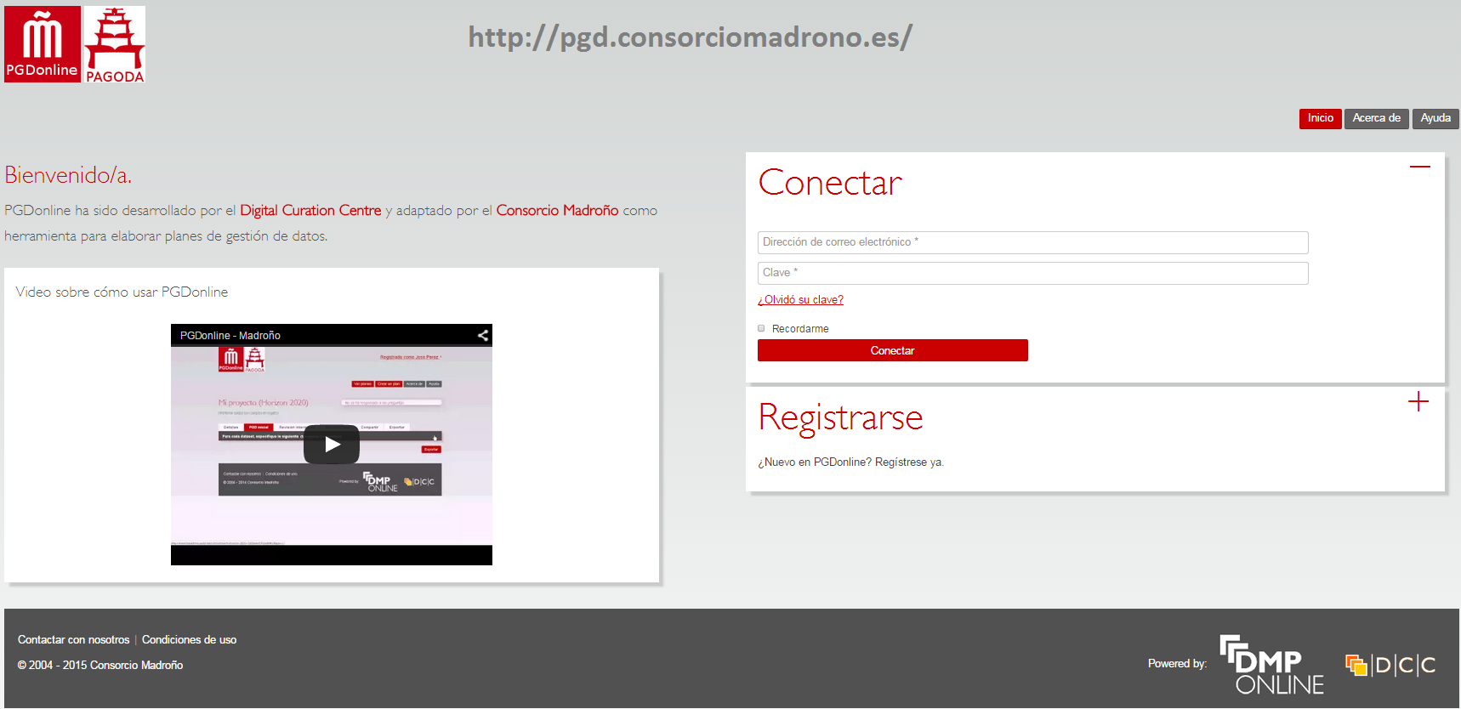
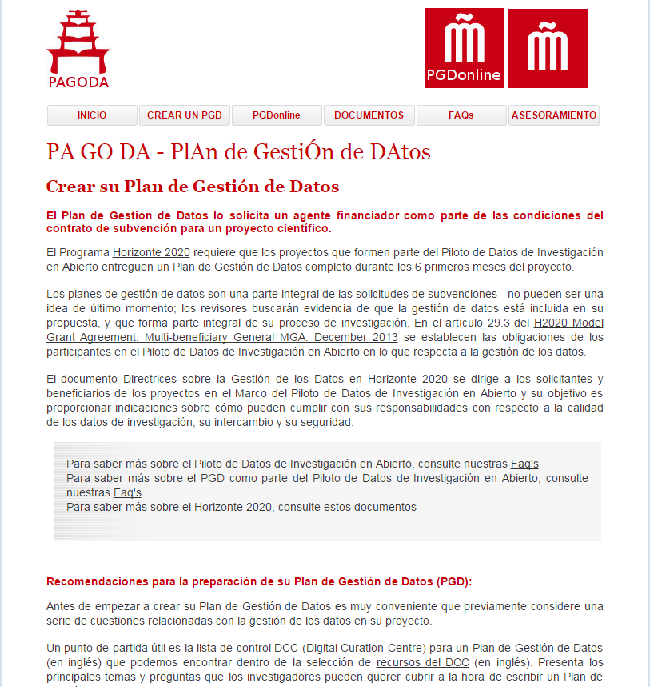
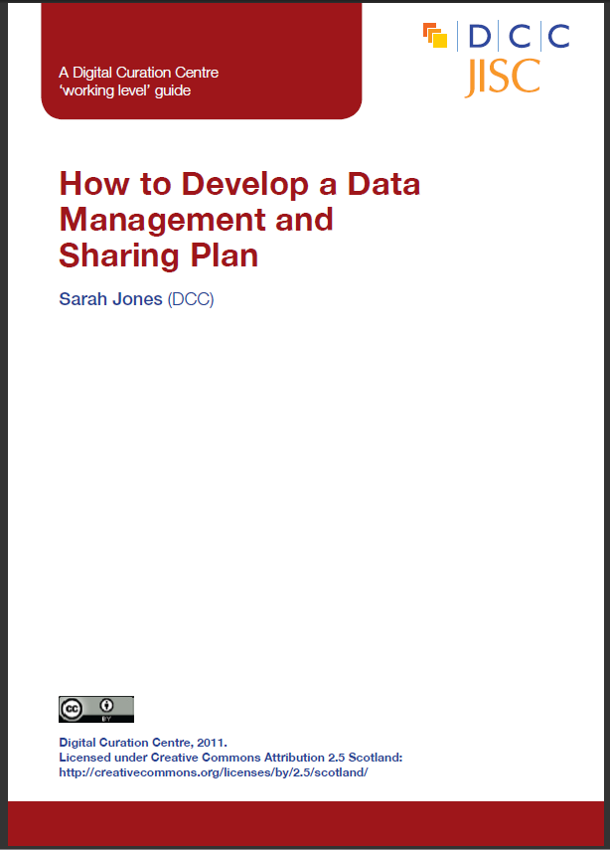
Guidance and tools
http://pgd.consorciomadrono.es/
www.dcc.ac.uk/resources/data-management-plans
Notes:
Spanish Madroño Consortium has created the PaGoDa website to help prepare the Data Management Plans required by Horizon 2020.
The following items are available on the website:
• A guide for Data Management Plans creation.
• The management tool PGDonline, which is the Spanish translation for DMPonline tool, developed by the Digital Curation Centre (DCC) in the United Kingdom.
• Guidelines on Data Management in Horizon 2020 in Spanish version.
We hope that this website will be a useful tool for researchers who have to tackle the task of drafting their Data Management Plans.

Slide 30
Tips for writing DMPs
Start early!
Do not to write the plan in isolation – seek advice from colleagues (ethics, IT, library)
Be realistic - base plans on available skills & support
The plan will - and should - change over time!

Slide 31
Thanks – any questions?
DMP guidance, tools and resources:
www.dcc.ac.uk/resources/data-management-plans
Follow us on twitter:
@digitalcuration and #DMPonline

